Slide 1
Chapter 5 – System Modeling

Slide 2
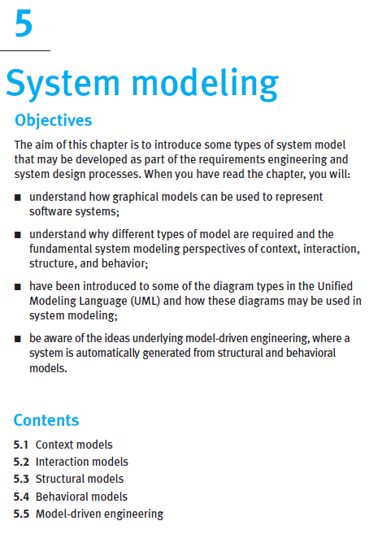
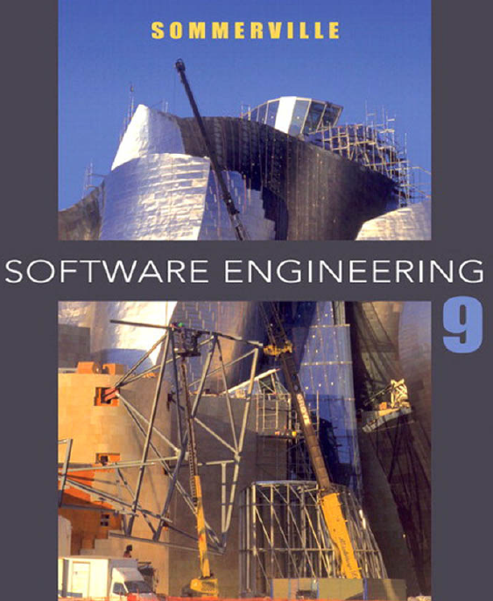
From the book
Read it online!

Slide 3
Chapter 5 – System Modeling - Topics covered
Context models
Interaction models
Structural models
Behavioral models
Model-driven engineering

Slide 4
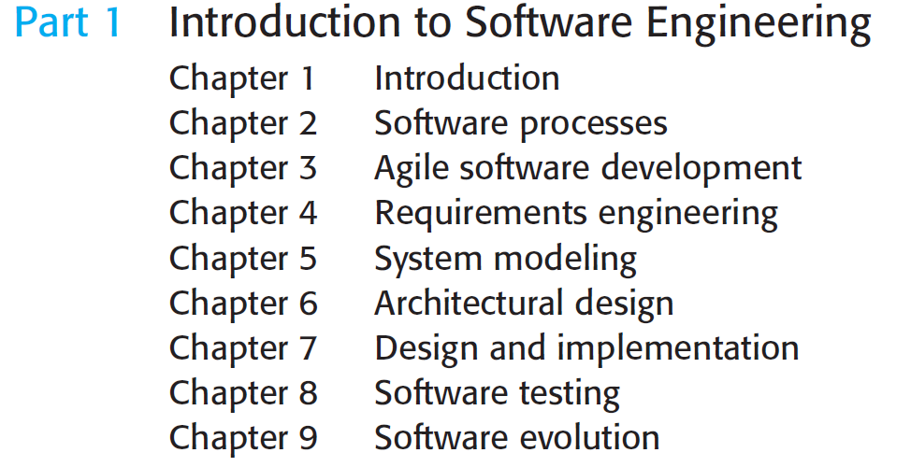
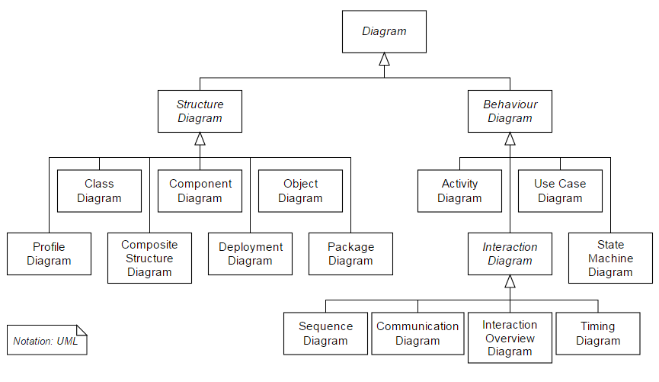
UML
14 diagrams in total
Ch. 5
Ch. 4

Slide 5
UML
Four types of diagrams may be used for interaction modelling.
14 diagrams in total

Slide 6
Interaction models – need to keep UI in mind
Users will INTERACT with the system using the GUI (UI)
Prototyping of GUI would be useful
Use cases:
Notes:
The objects and actors involved are listed along the top of the diagram, with a dotted line drawn vertically from these.
Interactions between objects are indicated by annotated arrows.

Slide 7
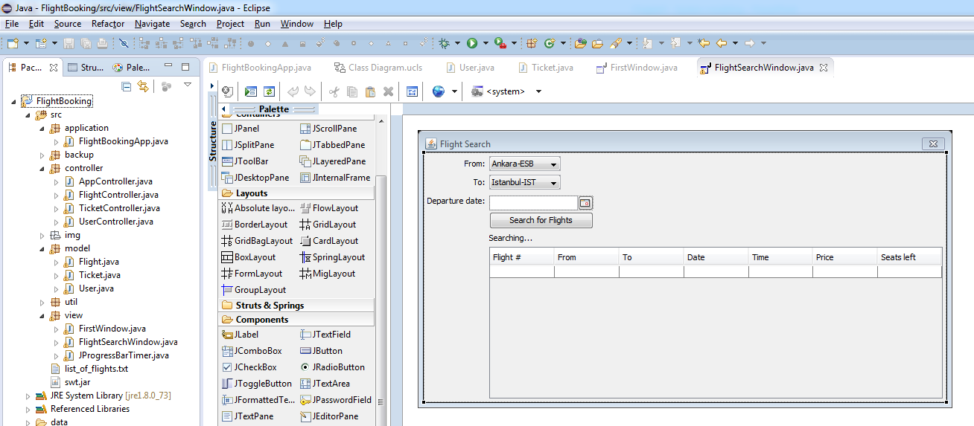
Design of Interaction models based on UI prototypes

Slide 8
Sequence diagram for Search for Flights use-case

Slide 9
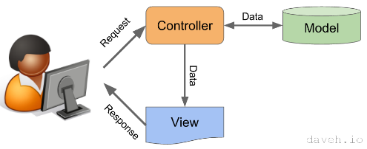


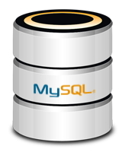

The Model-View-Controller (MVC) pattern
Controller
(brain, business logic)
View (UI)
Model

Slide 10

The Model-View-Controller (MVC) pattern

Slide 11

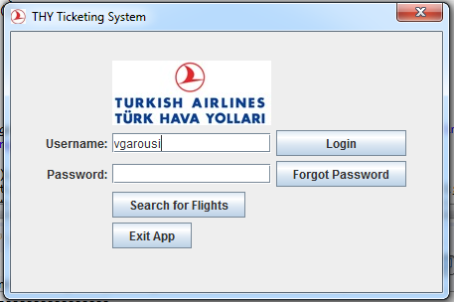
In-class exercise
Draw the sequence diagram for use-case “View My Tickets”
Time: 5 minutes

Slide 12
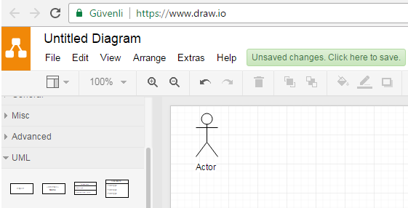
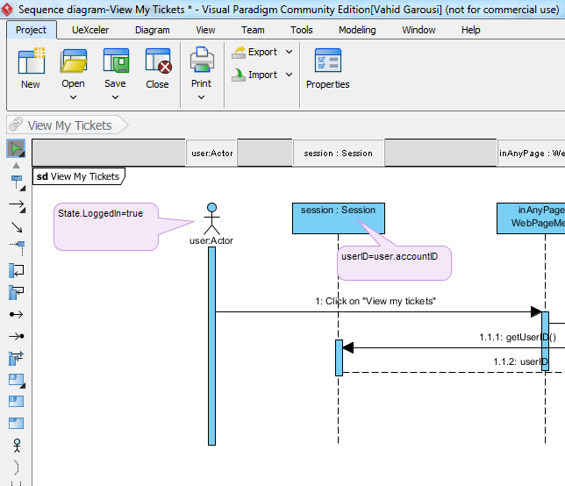
In-class exercise
Draw the sequence diagram for use-case “View My Tickets”
Let’s use online tools such as www.draw.io
Or http://www.visual-paradigm.com/download/community.jsp

Slide 13
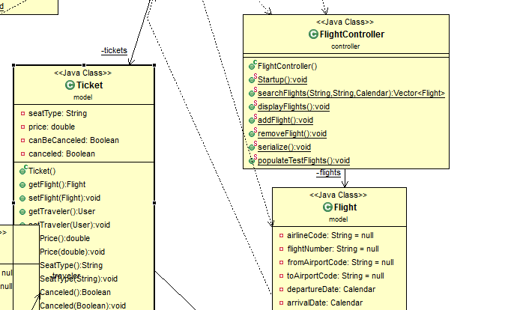
Sequence diagram for Search for Flights use-case
Important points:
All the method names on the message MUST exists in the class definitions
IN CLASS DIAGRAMS

Slide 14
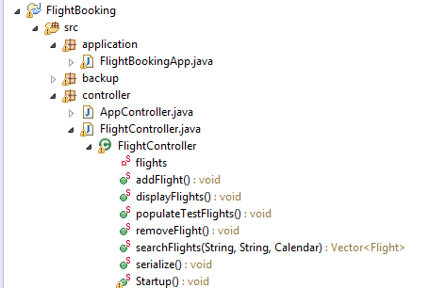
Sequence diagram for Search for Flights use-case
Important points:
All the method names on the message MUST exists in the class definitions
LATER IN THE SOURCE CODE

Slide 15
3) Interaction models
Modeling user interaction is important as it helps to identify user requirements.
Modeling system-to-system interaction highlights the communication problems that may arise.
Modeling component interaction helps us understand if a proposed system structure is likely to deliver the required system performance and dependability.

Slide 16
Interaction models - Sequence diagrams
Sequence diagrams are part of UML and are used to model interactions between actors and objects within a system.
A sequence diagram shows the sequence of interactions that take place during a particular use case or use case instance.
Notes:
The objects and actors involved are listed along the top of the diagram, with a dotted line drawn vertically from these.
Interactions between objects are indicated by annotated arrows.

Slide 17
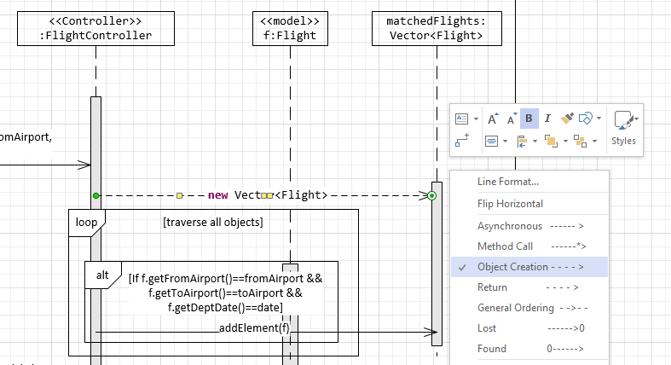
Sequence diagram for Search for Flights use-case
Important points:
Object creation messages…

Slide 18
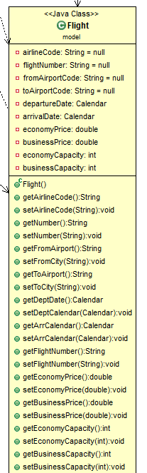
Sequence diagram
Important points:
All the method names on the message MUST exists in the class definitions
IN CLASS DIAGRAMS

Slide 19
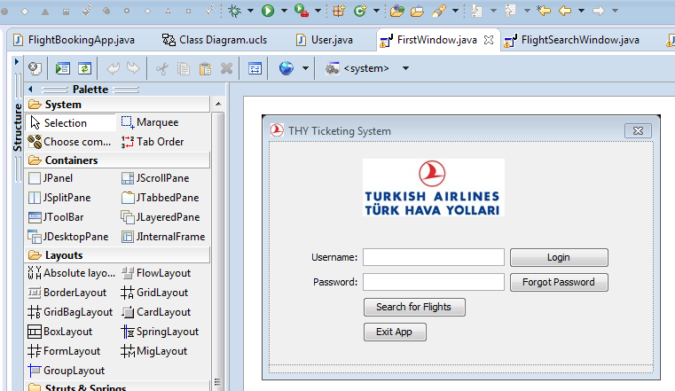
Sequence diagram for Login use-case
Solution is next…

Slide 20
Sequence diagram for Login use-case

Slide 21
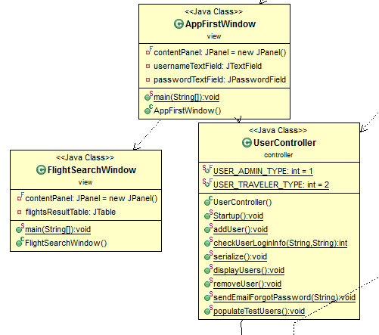
Sequence diagram for Login use-case

Slide 22
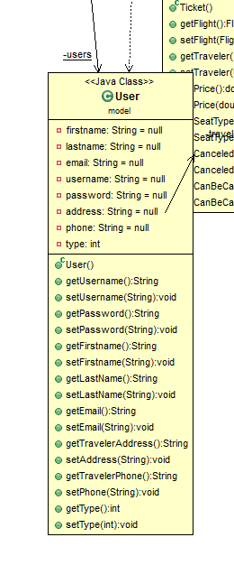
Sequence diagram for Login use-case

Slide 23
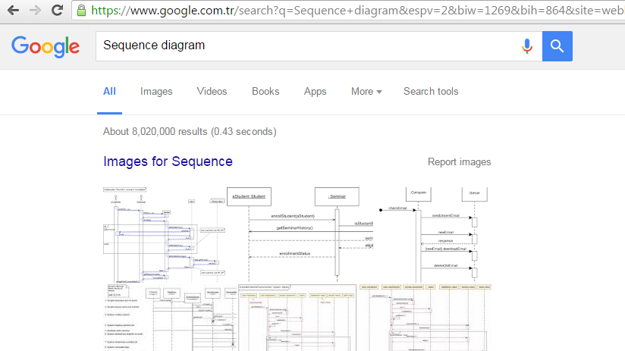
Sequence diagrams: learn more

Slide 24
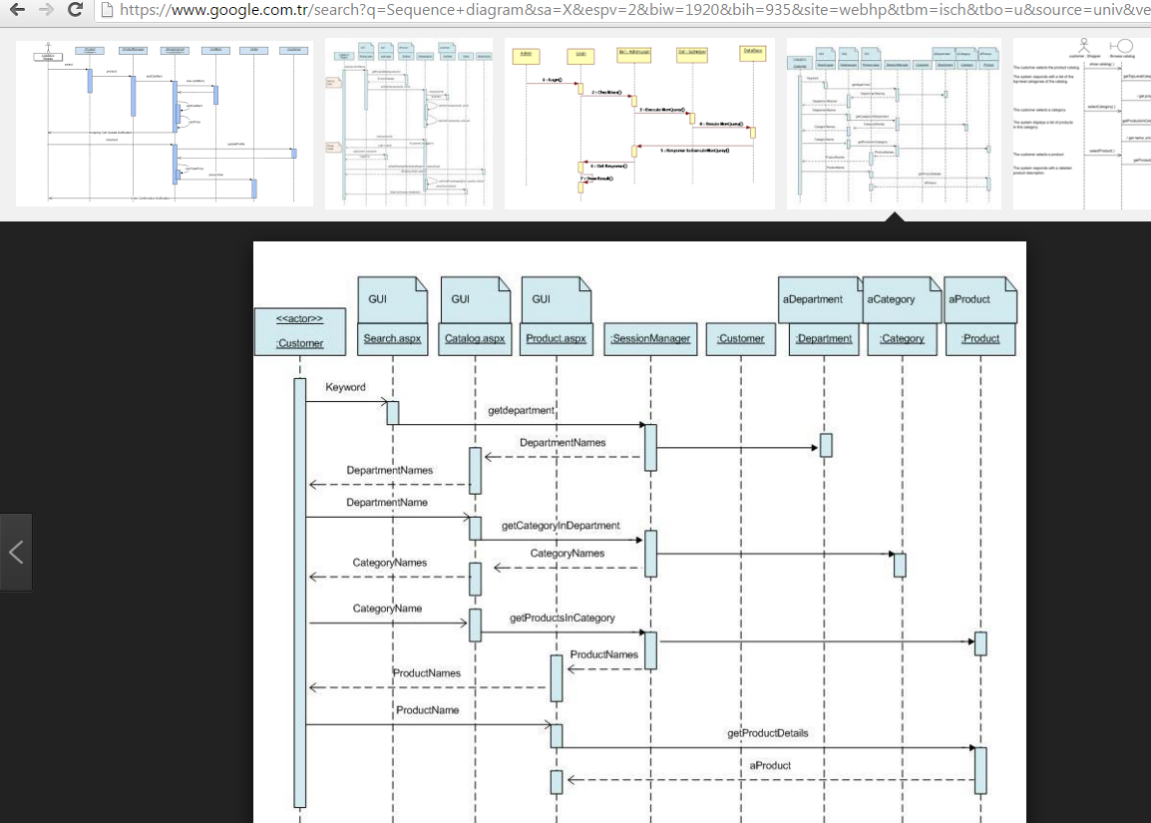
Sequence diagrams: learn more
This sequence diagram shows the flow of a search method. The user will enter a keyword or name of a product in the Search textbox on a Web form

Slide 25
Chapter 5 – System Modeling - Topics covered
Context models
Interaction models
Structural models
Behavioral models
Model-driven engineering

Slide 26
UML
14 diagrams in total
Ch. 5
Ch. 5
Ch. 6

Slide 27
Structural models - Class diagrams
Class diagrams are used when developing an object-oriented system model to show the classes in a system and the associations between these classes.
An association is a link between classes that indicates that there is some relationship between these classes.
When you are developing models during the early stages of the software engineering process, objects represent something in the real world, such as a patient, a prescription, doctor, etc.
Notes:
An object class can be thought of as a general definition of one kind of system object.

Slide 28
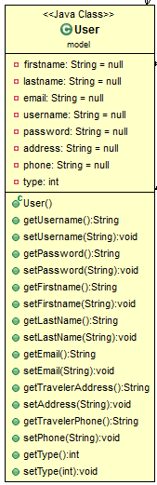
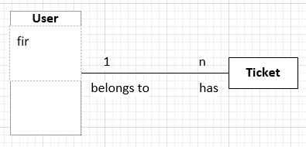
Adding methods and attributes for classes

Slide 29
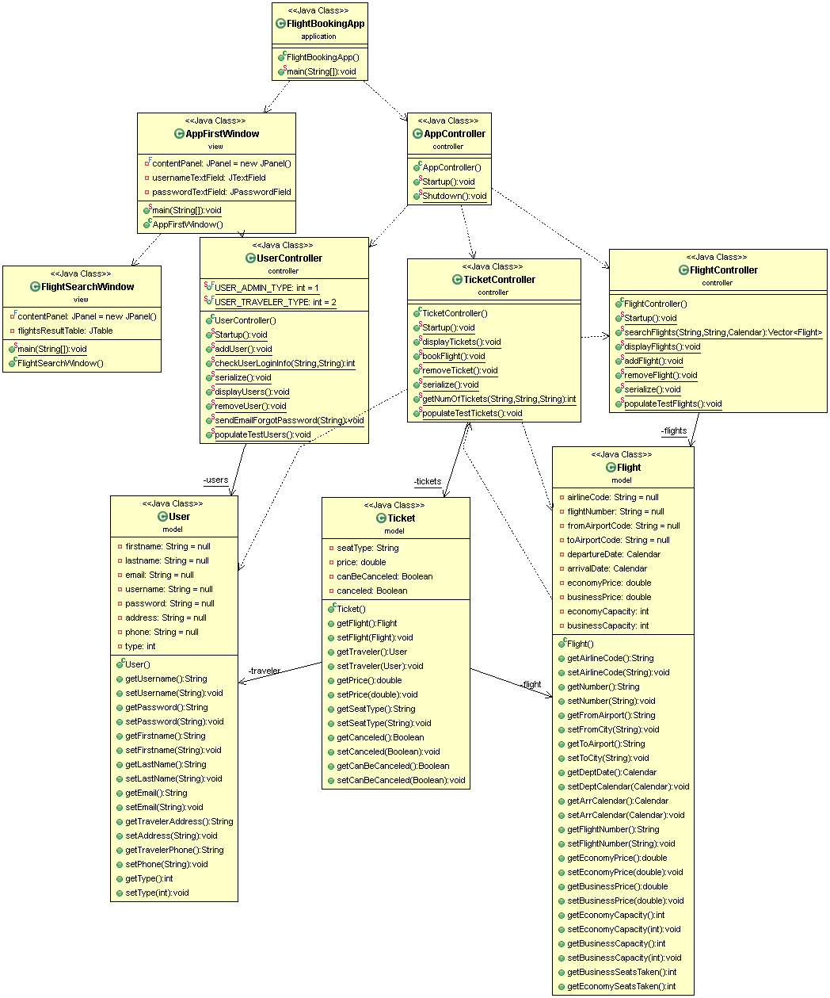
Classes and associations in FlightBooking System
Zoomed next…

Slide 30
Class diagram of FlightBooking

Slide 31
Class diagram of FlightBooking

Slide 32
4) Structural models
Structural models of software display the organization of a system in terms of the components that make up that system and their relationships.
You create structural models of a system when you are discussing and designing the system architecture.
Structural models may be static models, which show the structure of the system design, or dynamic models, which show the organization of the system when it is executing.

Slide 33
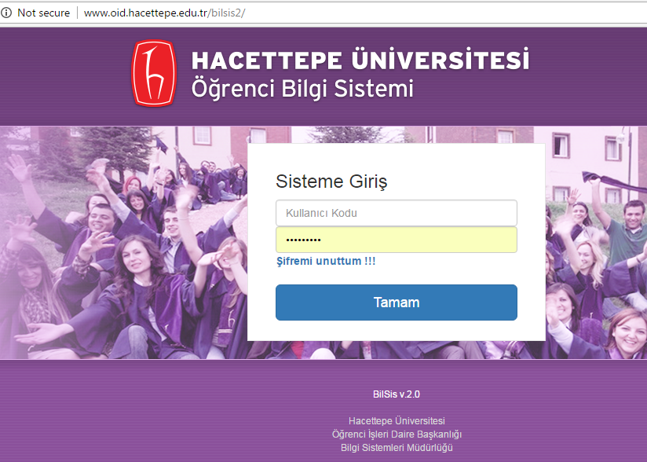
In-class exercise
System: student information system (like BILBSIS2)
Derive the classes and draw the class diagram
Time: 5 minutes

Slide 34
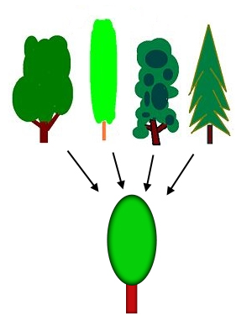
Generalization
Generalization is an everyday technique that we use to manage complexity.
Rather than learn the detailed characteristics of every entity that we experience, we place these entities in more general classes (trees, animals, cars, houses, etc.) and learn the characteristics of these classes.
This allows us to infer that different members of these classes have some common characteristics e.g. Çam, Kavak, Köknar -> Ağaç
tree

Slide 35
A generalization hierarchy with added detail
In object-oriented languages, such as Java, generalization is implemented using class inheritance mechanisms built into language.
Attributes and operations associated with higher-level classes (super-classes) are also associated with lower-level classes (subclasses.)
Subclasses inherit attributes and operations from their superclasses and add more specific attributes and operations.

Slide 36
Object class aggregation models
An aggregation model shows how classes that are collections are composed of other classes.
Aggregation models are similar to the part-of relationship in semantic data models.

Slide 37
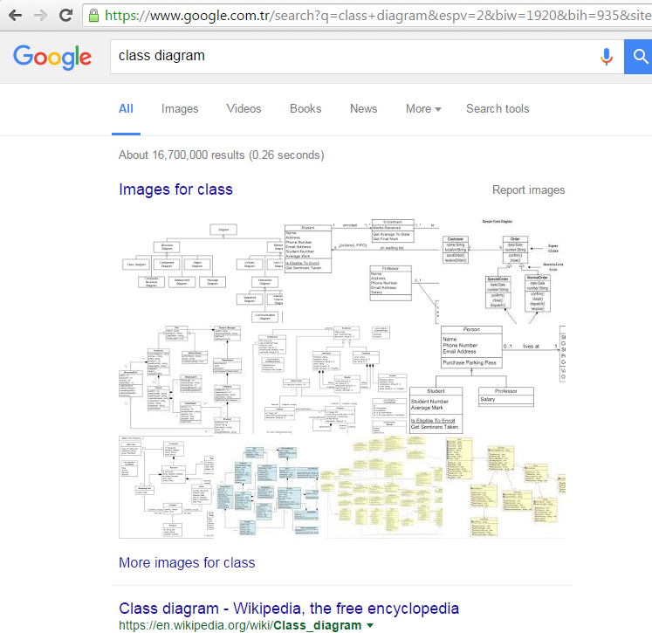
Class diagram: learn more online

Slide 38
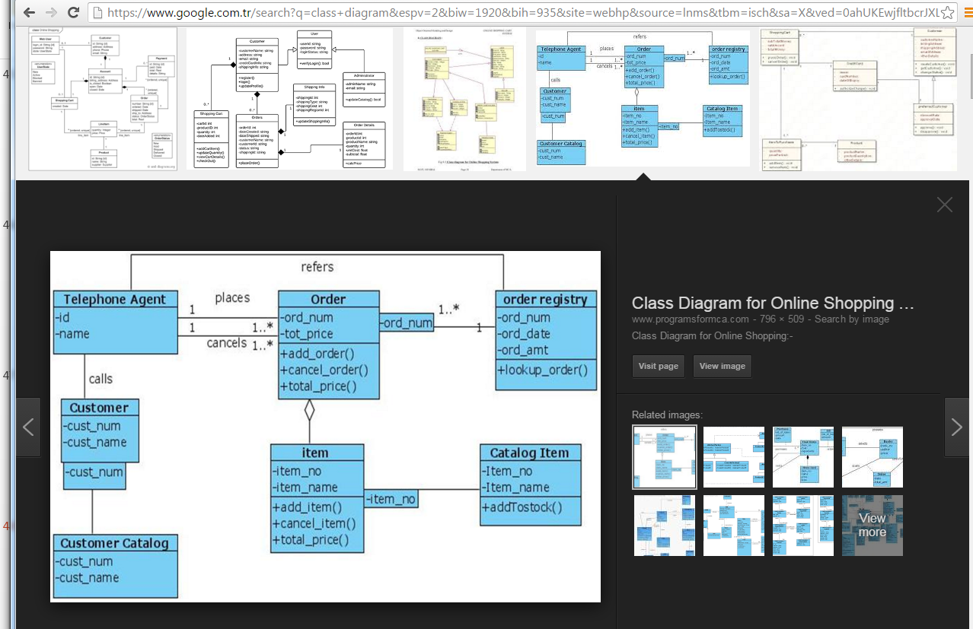
Class diagram: learn more online

Slide 39
Chapter 5 – System Modeling - Topics covered
Context models
Interaction models
Structural models
Behavioral models
Model-driven engineering

Slide 40
UML
14 diagrams in total
Ch. 4
Ch. 4, 6
Ch. 5

Slide 41
Data-driven modeling using activity diagrams

Slide 42
5) Behavioral models
Behavioral models are models of dynamic behavior of a system as it is executing. They show what happens or what is supposed to happen when a system responds to a stimulus from its environment.
You can think of these stimuli as being of two types:
Data Some data arrives that has to be processed by system.
Events Some event happens that triggers system processing. Events may have associated data, although this is not always the case.

Slide 43
Data-driven modeling
Many business systems are data-processing systems that are primarily driven by data. They are controlled by data input to the system, with relatively little external event processing.
Data-driven models show the sequence of actions involved in processing input data and generating an associated output.
They are particularly useful during analysis of requirements as they can be used to show end-to-end processing in a system.

Slide 44
Event-driven modeling
Real-time systems are often event-driven, with minimal data processing.
For example, a landline phone switching system responds to events such as ‘receiver off hook’ by generating a dial tone.
Event-driven modeling shows how a system responds to external and internal events.
It is based on the assumption that a system has a finite number of states and that events (stimuli) may cause a transition from one state to another.

Slide 45
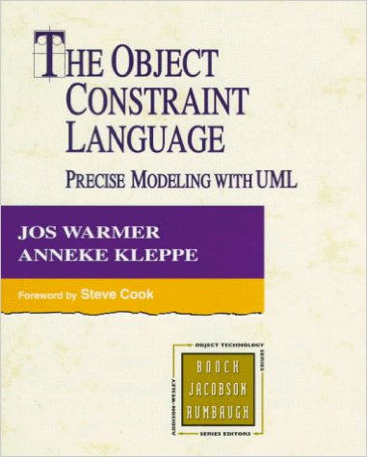
State diagram of Flight class
Only for state-dependent classes/objects
OCL

Slide 46
In-class exercise
Draw the state diagram for class Ticket
Time: 5 minutes

Slide 47
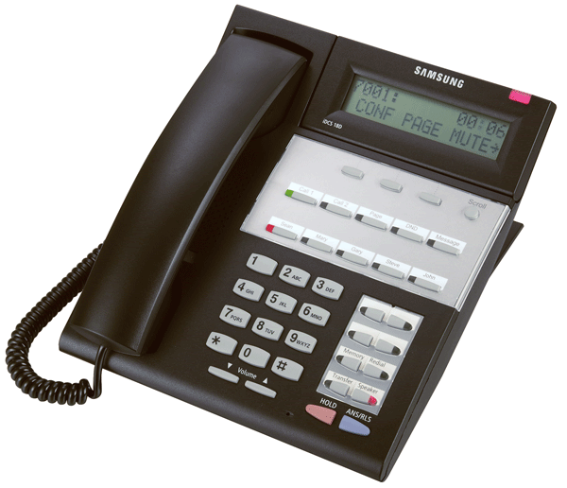
State chart of a land-line phone

Slide 48

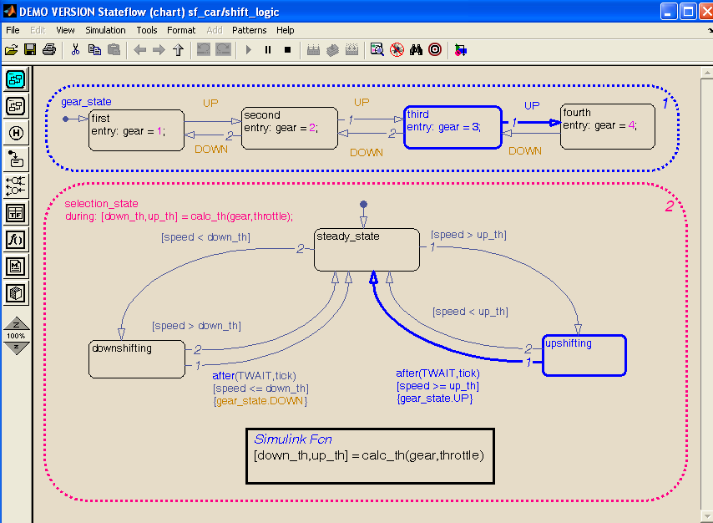
State charts for Control and Embedded Systems in Matlab Simulink (can be directly executed – converted to code)

Slide 49
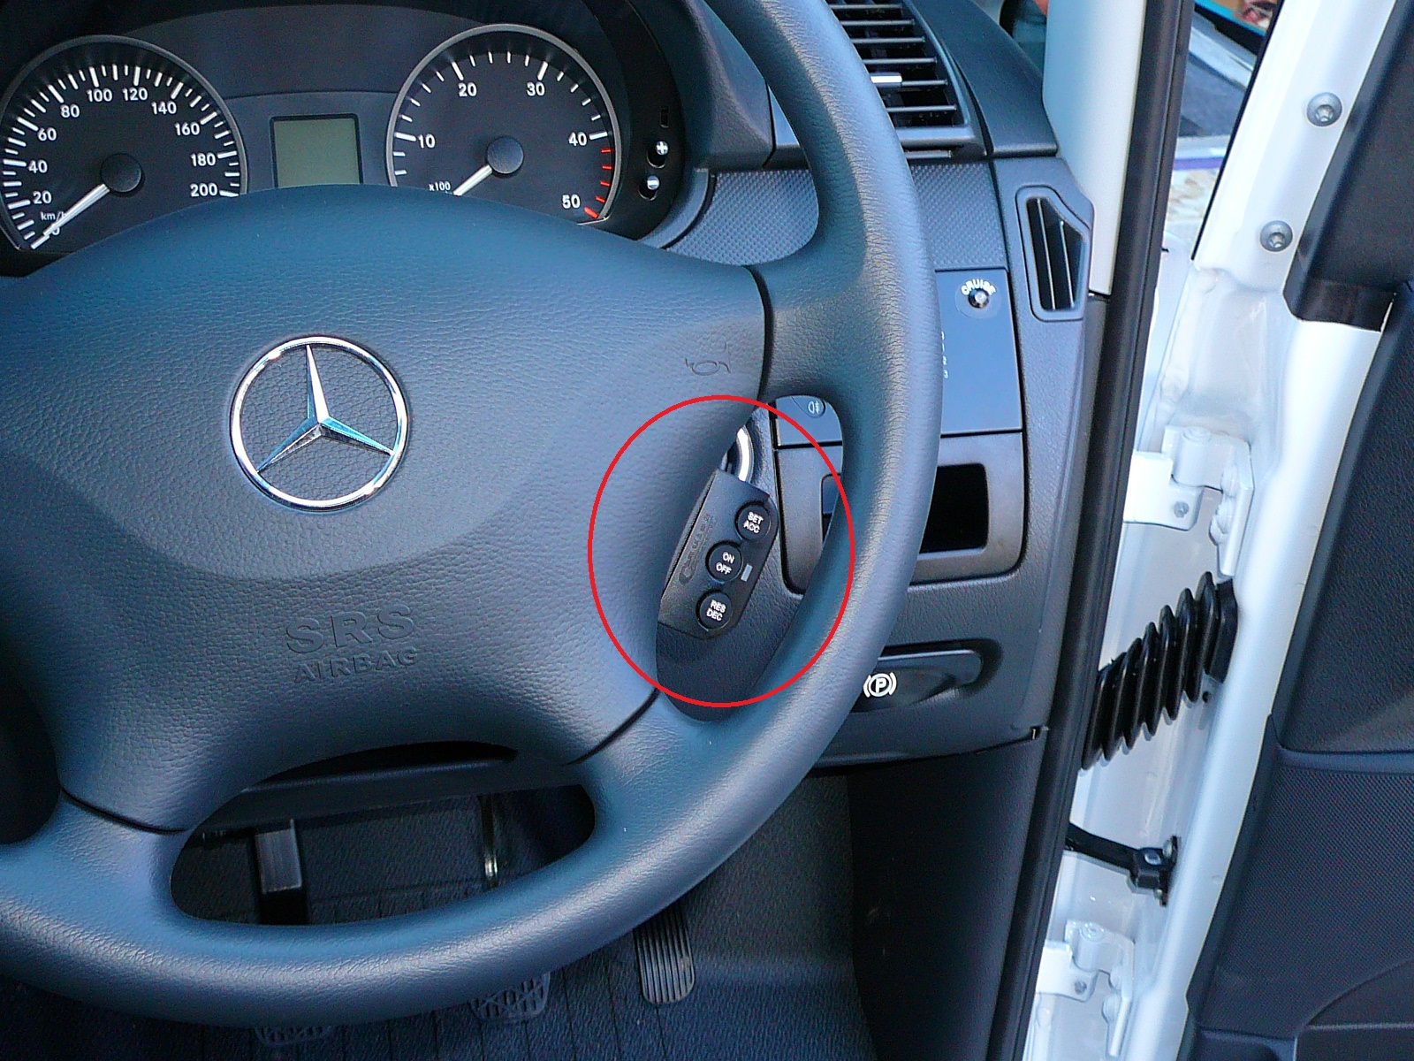
State charts a cruise control system
Notes:
A. J. Offutt and A. Abdurazik, “Generating Tests from UML specifications,” Proc. 2nd International Conference on the Unified Modeling Language (UML'99), Fort Collins, CO, pp. 416-429, October, 1999.
A. J. Offutt, Y. Xiong and S. Liu, "Criteria for Generating Specification-based Tests," Proc. 5th International Conference on Engineering of Complex Computer Systems (ICECCS'99), Las Vegas, NV, pp. 119-129, October, 1999.
Coverage was measured using the ATAC tool (now called Xsuds), from Telcordia technologies in the US
URL: xsuds.research.telcordia.com

Slide 50
State machine models
These model the behaviour of the system in response to external and internal events.
They show the system’s responses to stimuli so are often used for modelling real-time systems.
State machine models show system states as nodes and events as arcs between these nodes. When an event occurs, the system moves from one state to another.
State-charts are an integral part of the UML and are used to represent state machine models.

Slide 51
Chapter 5 – System Modeling - Topics covered
Context models
Interaction models
Structural models
Behavioral models
Model-Driven engineering (MDE)

Slide 52
Model-Driven Engineering (MDE)
Model-driven engineering (MDE) is an approach to software development where models rather than programs are principal outputs of development process.
Programs that execute on a hardware/software platform are then generated automatically from models.
Proponents of MDE argue that this raises the level of abstraction in software engineering so that engineers no longer have to be concerned with programming language details or the specifics of execution platforms.

Slide 53
Usage of Model-Driven Engineering (MDE)
MDE is still at an early stage of development, and it is unclear whether or not it will have a significant effect on software engineering practice.
Pros
Allows systems to be considered at higher levels of abstraction
Generating code automatically means that it is cheaper to adapt systems to new platforms.
Cons
Models for abstraction and not necessarily right for implementation.
Savings from generating code may be outweighed by costs of developing translators for new platforms.

Slide 54
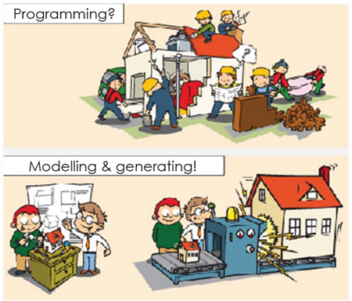
A metaphor for Model-Driven Engineering
Ref:http://www.theenterprisearchitect.eu/blog/2009/08/05/a-metaphor-for-model-driven-engineering/
Notes:
A metaphor for Model Driven Engineering (MDE)
Read more at: http://www.theenterprisearchitect.eu/blog/2009/08/05/a-metaphor-for-model-driven-engineering/

Slide 55
Executable UML
The fundamental notion behind model-driven engineering is that completely automated transformation of models to code should be possible.
This is possible using a subset of UML 2, called Executable UML or xUML.

Slide 56
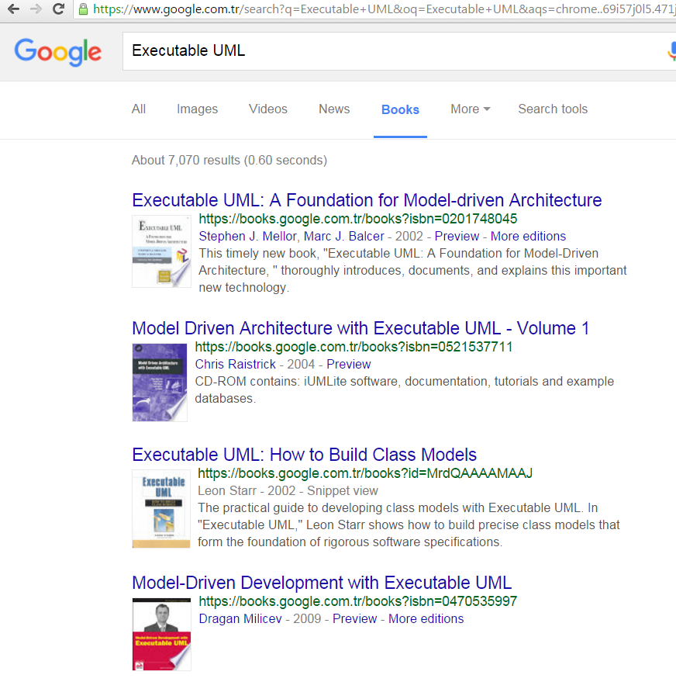
Books

Slide 57
Tools for ‘Executable UML‘

Slide 58
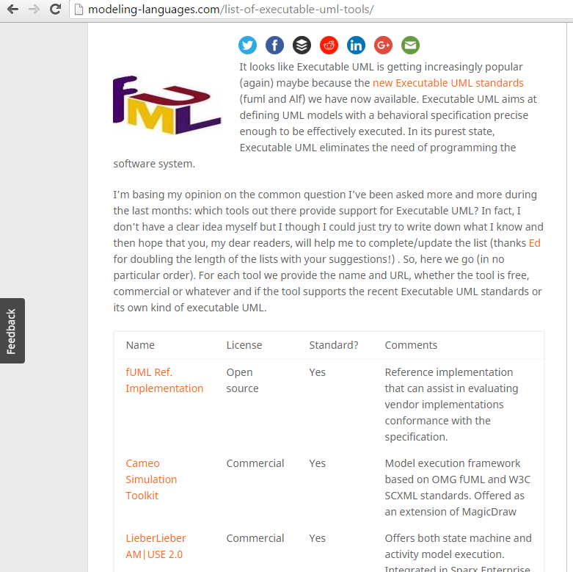
Tools for ‘Executable UML‘
Many!

Slide 59
End of Chapter 5

Slide 60
For students

Slide 61
State diagram of Ticket class
Only for state-dependent classes/objects

Slide 62
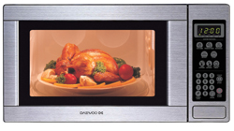
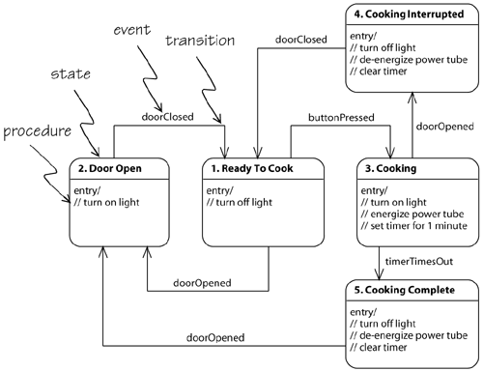
Example: Embedded software to control a microwave oven

Slide 63
Context models - System boundaries
System boundaries are established to define what is inside and what is outside the system.
They show other systems that are used or depend on the system being developed.
The position of the system boundary has a profound effect on the system requirements.
Defining a system boundary is a political judgment
There may be pressures to develop system boundaries that increase / decrease the influence or workload of different parts of an organization.
Social and organisational concerns may affect the decision on where to position system boundaries.

Slide 64
2) Process process models
Context models simply show the other systems in the environment, not how the system under development (SuD) is used in that environment.
Process models reveal how SuD is used in broader business processes.
UML activity diagrams may be used to define business process models.

Slide 65
Process model of involuntary detention

Slide 66
Interaction models - Use case modeling
Use cases were developed originally to support requirements elicitation and now incorporated into UML.
Each use case represents a discrete task that involves external interaction with a system.
Actors in a use case may be people or other systems.
Represented diagrammatically to provide an overview of use case and in a more detailed textual form.
A use case in MHC-PMS

Slide 67
Use cases in MHC-PMS involving role ‘Medical Receptionist’

Slide 68
Tabular description of Transfer data use-case
MHC-PMS: Transfer data
Actors | Medical receptionist, patient records system (PRS)
Description | A receptionist may transfer data from the MHC-PMS to a general patient record database that is maintained by a health authority. The information transferred may either be updated personal information (address, phone number, etc.) or a summary of the patient’s diagnosis and treatment.
Data | Patient’s personal information, treatment summary
Stimulus | User command issued by medical receptionist
Response | Confirmation that PRS has been updated
Comments | The receptionist must have appropriate security permissions to access the patient information and the PRS.

Slide 69
Sequence diagram for View Patient Info

Slide 70
Sequence diagram for Transfer Data

Slide 71
Classes and associations in MHC-PMS

Slide 72
Order processing

Slide 73
State diagram of a microwave oven

Slide 74
States and stimuli for the microwave oven (a)
State | Description
Waiting | The oven is waiting for input. The display shows the current time.
Half power | The oven power is set to 300 watts. The display shows ‘Half power’.
Full power | The oven power is set to 600 watts. The display shows ‘Full power’.
Set time | The cooking time is set to the user’s input value. The display shows the cooking time selected and is updated as the time is set.
Disabled | Oven operation is disabled for safety. Interior oven light is on. Display shows ‘Not ready’.
Enabled | Oven operation is enabled. Interior oven light is off. Display shows ‘Ready to cook’.
Operation | Oven in operation. Interior oven light is on. Display shows the timer countdown. On completion of cooking, the buzzer is sounded for five seconds. Oven light is on. Display shows ‘Cooking complete’ while buzzer is sounding.

Slide 75
States and stimuli for the microwave oven (b)
Stimulus | Description
Half power | The user has pressed the half-power button.
Full power | The user has pressed the full-power button.
Timer | The user has pressed one of the timer buttons.
Number | The user has pressed a numeric key.
Door open | The oven door switch is not closed.
Door closed | The oven door switch is closed.
Start | The user has pressed the Start button.
Cancel | The user has pressed the Cancel button.

Slide 76
Microwave oven operation

Slide 77
Model-Driven Architecture (MDA)
Model-driven architecture (MDA) was the precursor of more general model-driven engineering
MDA is a model-focused approach to software design and implementation that uses a subset of UML models to describe a system.
Models at different levels of abstraction are created. From a high-level, platform independent model, it is possible, in principle, to generate a working program without manual intervention.
Notes:
Precursor (n) - somebody or something that comes earlier.

Slide 78
Types of model
A computation independent model (CIM)
These model the important domain abstractions used in a system. CIMs are sometimes called domain models.
A platform independent model (PIM)
These model the operation of system without reference to its implementation. The PIM is usually described using UML models that show the static system structure and how it responds to external and internal events.
Platform specific models (PSM)
These are transformations of platform-independent model with a separate PSM for each application platform. In principle, there may be layers of PSM, with each layer adding some platform-specific detail.

Slide 79
MDA transformations

Slide 80
Types of model
A computation independent model (CIM)
These model the important domain abstractions used in a system. CIMs are sometimes called domain models.

Slide 81
Types of model
A platform independent model (PIM)
These model the operation of system without reference to its implementation. The PIM is usually described using UML models that show the static system structure and how it responds to external and internal events.

Slide 82
Types of model
Platform specific models (PSM)
These are transformations of platform-independent model with a separate PSM for each application platform. In principle, there may be layers of PSM, with each layer adding some platform-specific detail.

Slide 83
Multiple platform-specific models

